Slide 1

Intro to
Cloud Computing

Slide 2

Slido for QNA
https://app.sli.do/event/wCDFFp9ahBJTtK6AHpPT2Z

Slide 3
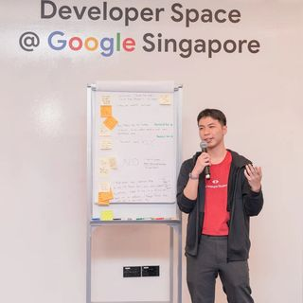


Lai Kai Yong (Vandyck)
Full Stack Software Engineer
GDSC Lead @APU
MLSA
@vandyck.lai
Kai Yong Lai (Vandyck)

Slide 4


Cloud Type
Hybrid Cloud
+
Private Cloud
Traditional Way
or
Third Party Managed
Public Cloud
(Third party managed)

Slide 5










Cloud Service
Infrastructure as a Service (IaaS)
Platform as a
Service (PaaS)
Software as a Service (SaaS)

Slide 6
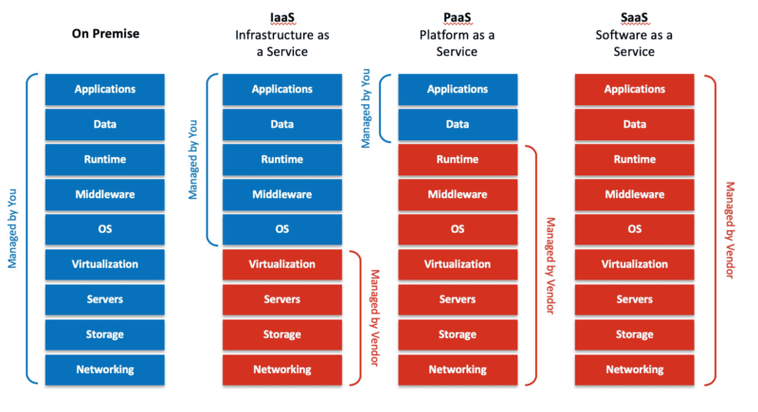

Slide 7








Some Common Category
AI / ML
Compute
Database
Internet of Things (IoT)
Security / Compliance
Networking

Slide 8



Benefits
Cost Efficient
Scalability
Speed

Slide 9
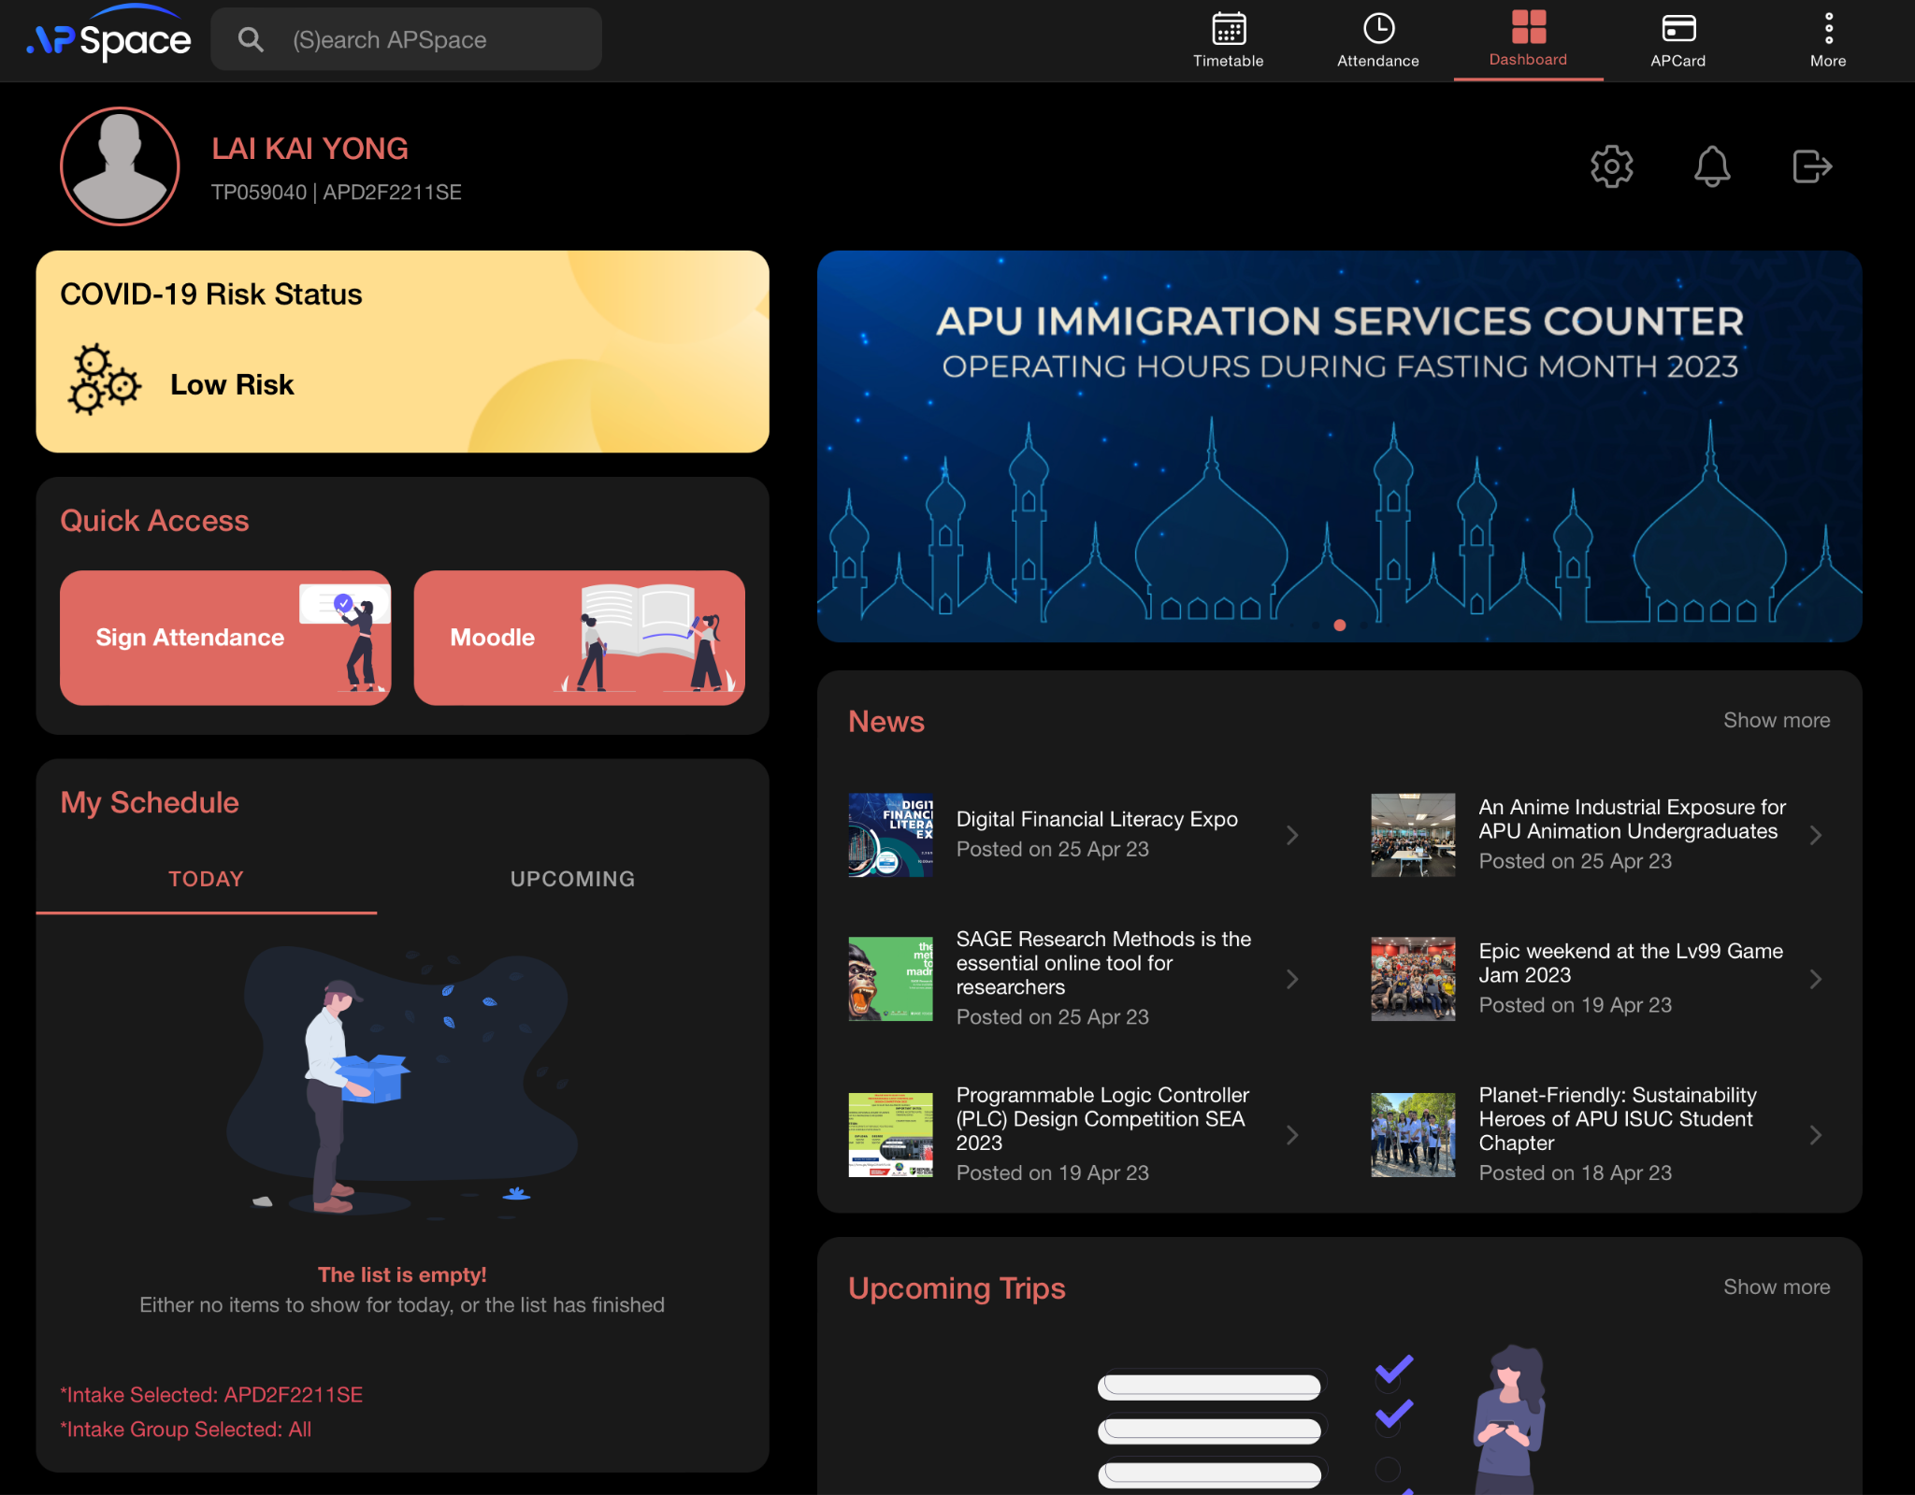
APSpace: Discussion
https://apspace.apu.edu.my/

